Slide 1




Pie Charts

Slide 2

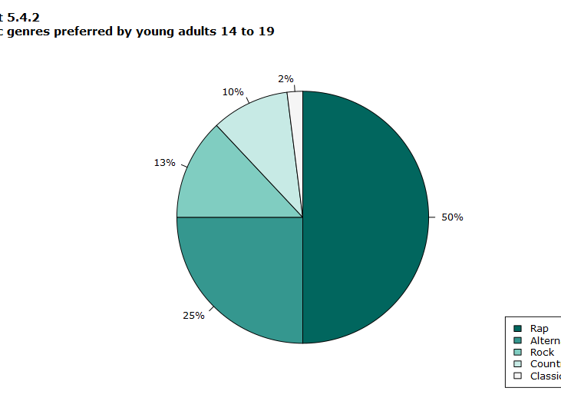

Key Characteristics
Pie charts are best for visualizing how different components contribute to a total amount, such as percentages of revenue from different products or the breakdown of a budget.
Pie charts are generally not recommended for showing changes over time or when there are many categories, as they can become difficult to read.

Slide 3
Most Common Uses
Representing sample data: Showing proportions of data points belonging to different categories, such as demographics, sales categories, or survey results.
Illustrating financial data: Displaying percentages of revenue from different products, profits from various countries, or how quarterly sales contribute to annual sales.
Comparing contributions to a total: Highlighting the relationship of individual components to a total, like votes by candidate or the number of transactions by user type.

